Slide 1
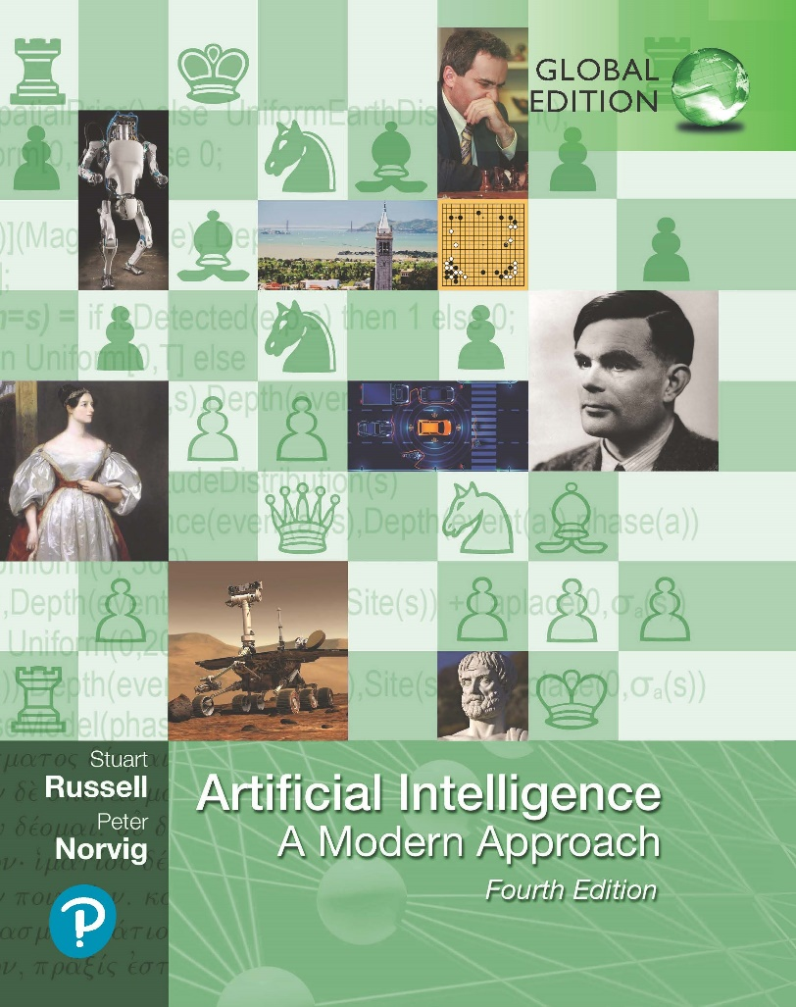
Artificial Intelligence: A Modern Approach
Fourth Edition, Global Edition
Chapter 14
Probabilistic Reasoning
Over Time
© 2022 Pearson Education Ltd.

Slide 2
Outline
Time and Uncertainty
Inference in Temporal Models
Hidden Markov Models
Kalman Filters
Dynamic Bayesian Networks
© 2022 Pearson Education Ltd.

Slide 3
Time and Uncertainty
States and observations
discrete-time models, in which the world is viewed as a series of snapshots or time slices
the time interval ∆ between slices is assumed to be the same for every interval.
X_{t}: denotes the set of state variables at time t, which are assumed to be unobservable
E_{t} : denotes the set of observable evidence variables.
The observation at time t is E_{t} = e_{t}
Transition and sensor models
The transition model specifies the probability distribution over the latest state variables, given the previous values: P(X_{t} | X_{0:t−1}).
Problem: the set X_{0:t−1} is unbounded in size as t increases.
Solution: Markov assumption [the current state depends on only a finite fixed number of previous states]
First order, P(X_{t} | X_{t−1}); Second order, P(X_{t} | X_{t-2}, X_{t−1});
P(E_{t} | X_{t}) is our sensor model, sensor Markov assumption:
P(E_{t} | X_{0:t}, E_{1:t−1}) = P(E_{t} | X_{t})

Slide 4
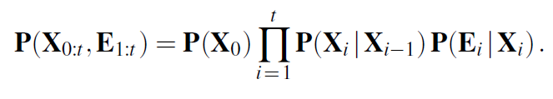
Time and Uncertainty
the prior probability distribution at time 0, P(X₀).
Umbrella World: first-order Markov process—the probability of rain is assumed to depend only on whether it rained the previous day
The first-order Markov assumption says that the state variables contain all the information needed to characterize the probability distribution for the next time slice.
Ways to improve the accuracy of the approximation
Increasing the order of the Markov process mode
Increasing the set of state variables

Slide 5
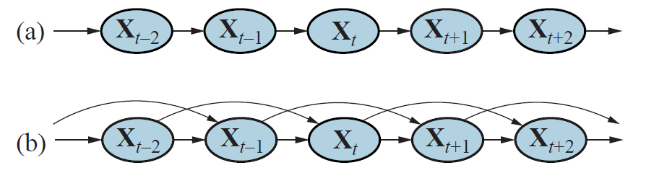
Time and Uncertainty
Bayesian network structure corresponding to a first-order Markov process with state defined by the variables X_{t}
A second-order Markov process.

Slide 6
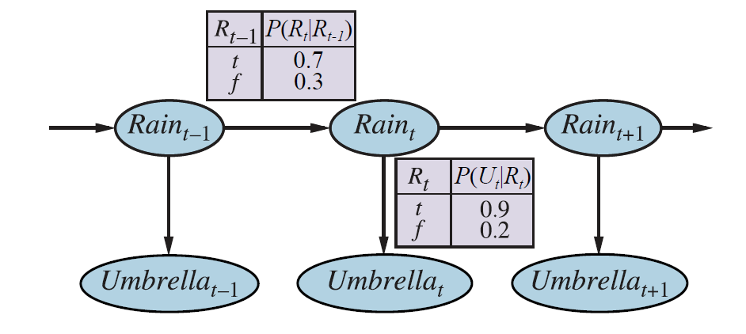
Time and Uncertainty
Bayesian network structure and conditional distributions describing the um- brella world. The transition model is P(Rain_{t} |Rain_{t−1}) and the sensor model is P(Umbrella_{t} |Rain_{t}).

Slide 7
Inference in Temporal Models
formulate the basic inference tasks that must be solved:
Filtering or state estimation is the task of computing the belief state P(X_{t} | e_{1:t})
Prediction: This is the task of computing the posterior distribution over the future state, given all evidence to date.
Smoothing: This is the task of computing the posterior distribution over a past state, given all evidence up to the present
Most likely explanation: Given a sequence of observations, we might wish to find the sequence of states that is most likely to have generated those observations
Besides inference tasks:
Learning: The transition and sensor models, if not yet known, can be learned from observations

Slide 8

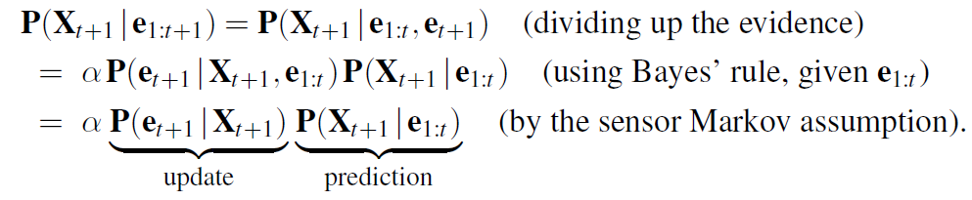
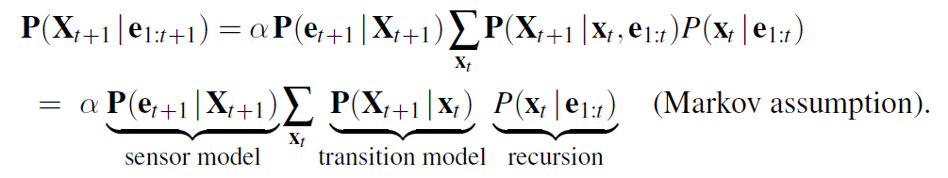
Inference in Temporal Models
Filtering and prediction

Slide 9
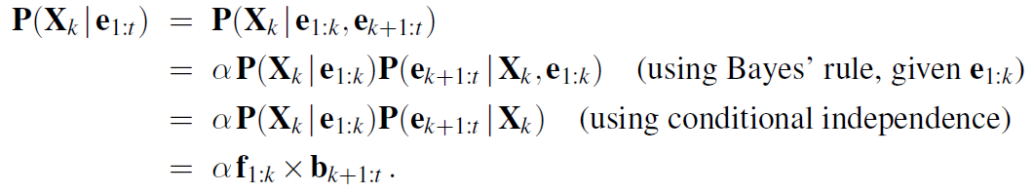
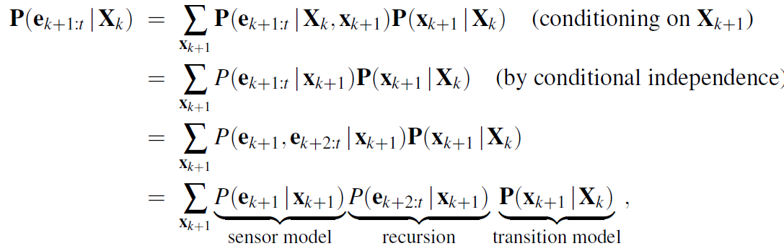
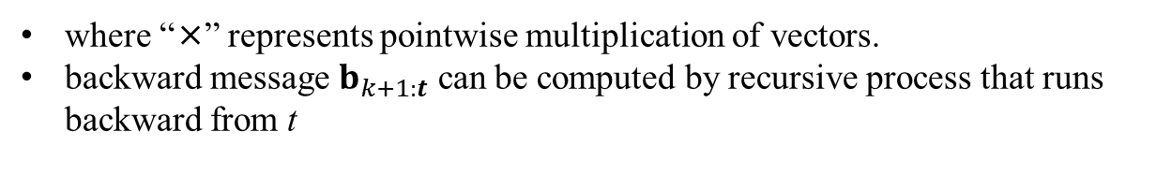
Inference in Temporal Models
Smoothing
where “×” represents pointwise multiplication of vectors.
backward message $b_{k+1:t}$ can be computed by recursive process that runs backward from t

Slide 10
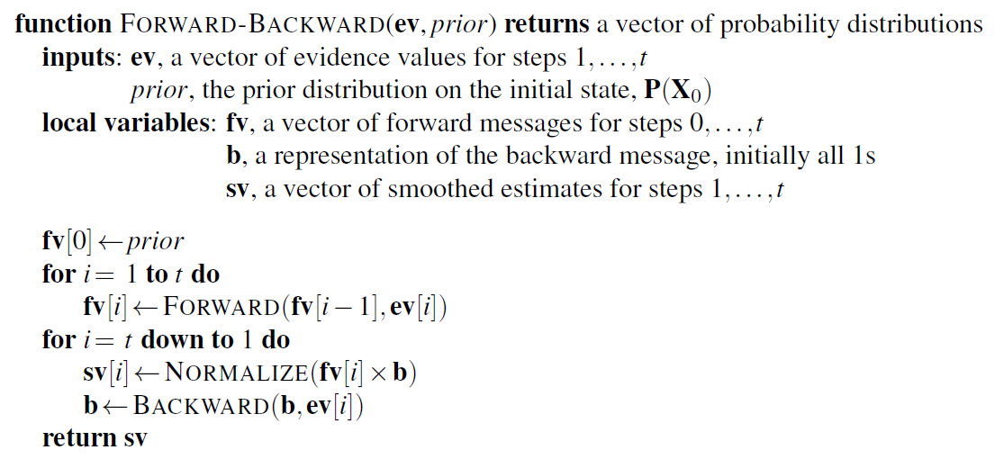
Inference in Temporal Models
The forward–backward algorithm for smoothing: computing posterior probabilities of a sequence of states given a sequence of observations

Slide 11
Inference in Temporal Models
Finding the most likely sequence
There is a linear-time algorithm for finding the most likely sequence
It relies on the same Markov property that yielded efficient algorithms for filtering and smoothing
view each sequence as a path through a graph whose nodes are the possible states at each time step.
likelihood of any path is the product of the transition probabilities along the path and the probabilities of the given observations at each state
there is a recursive relationship between most likely paths to each state x_{t+1} and most likely paths to each state x_{t}

Slide 12

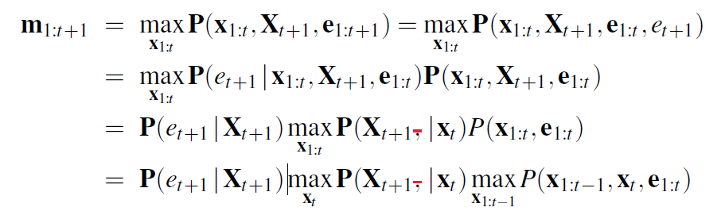
Inference in Temporal Models
Finding the most likely sequence
Recursively computed message m_{1:t}
m_{1:t} will contain the probability for the most likely sequence reaching each of the final states.
Viterbi algorithm:
select the final state of the most likely sequence overall. In order to identify the actual sequence, as opposed to just computing its probability, the algorithm will also need to record, for each state, the best state that leads to it

Slide 13
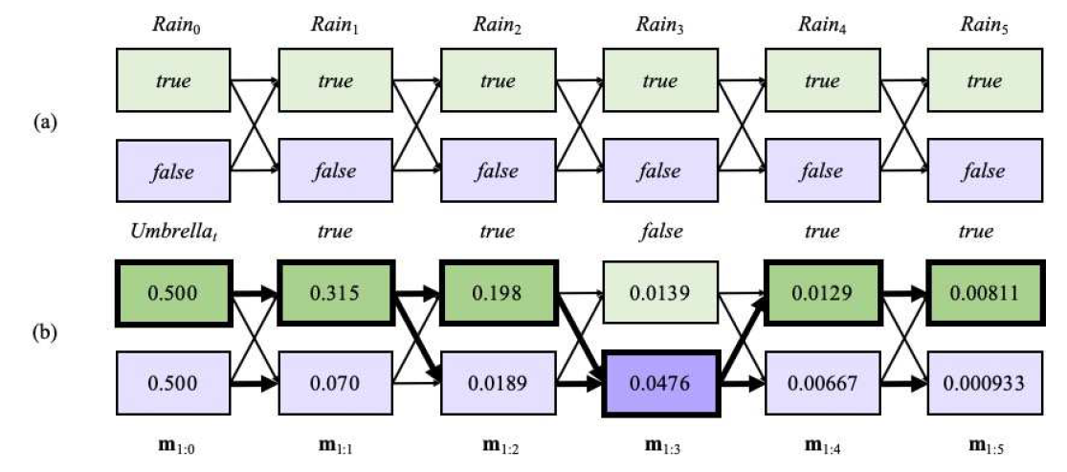
Inference in Temporal Models
Possible state sequences for Rain can be viewed as paths through a graph of the possible states at each time step.
Operation of the Viterbi algorithm for the umbrella observation sequence [true; true; false; true; true], where the evidence starts at time 1.

Slide 14
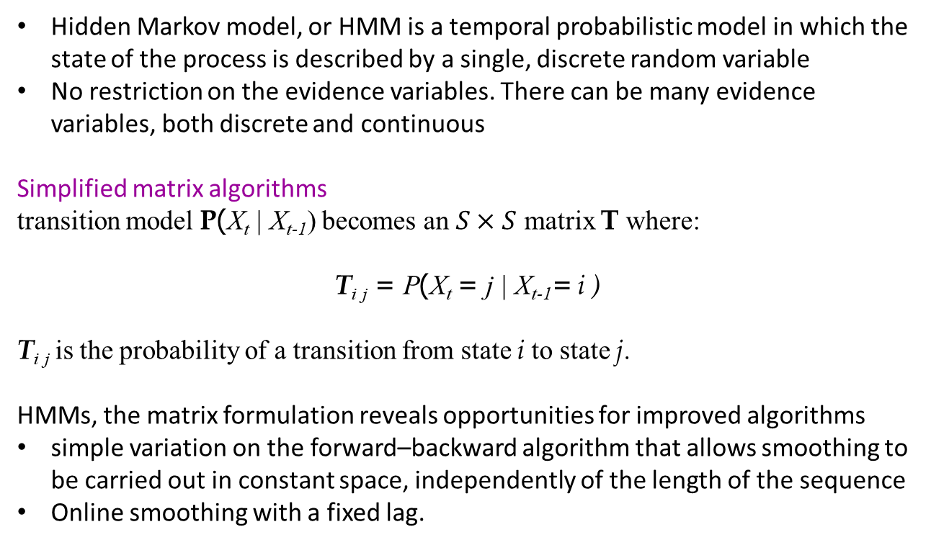
Hidden Markov Models
Hidden Markov model, or HMM is a temporal probabilistic model in which the state of the process is described by a single, discrete random variable
No restriction on the evidence variables. There can be many evidence variables, both discrete and continuous
Simplified matrix algorithms
transition model P(X_{t} | X_{t-1}) becomes an $S×S$ matrix T where:
T_{i} _{j} = P(X_{t} = j | X_{t-1}= i )
T_{i} _{j} is the probability of a transition from state i to state j.
HMMs, the matrix formulation reveals opportunities for improved algorithms
simple variation on the forward–backward algorithm that allows smoothing to be carried out in constant space, independently of the length of the sequence
Online smoothing with a fixed lag.

Slide 15
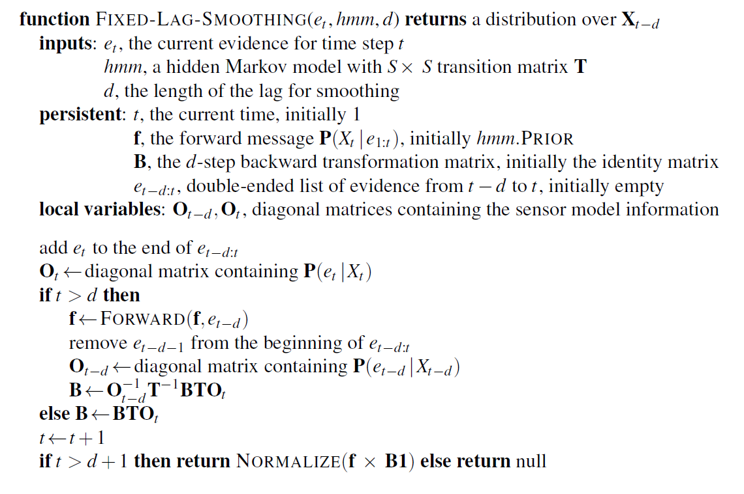
Hidden Markov Models
An algorithm for smoothing with a fixed time lag of d steps, implemented as an online algorithm that outputs the new smoothed estimate given the observation for a new time step.

Slide 16
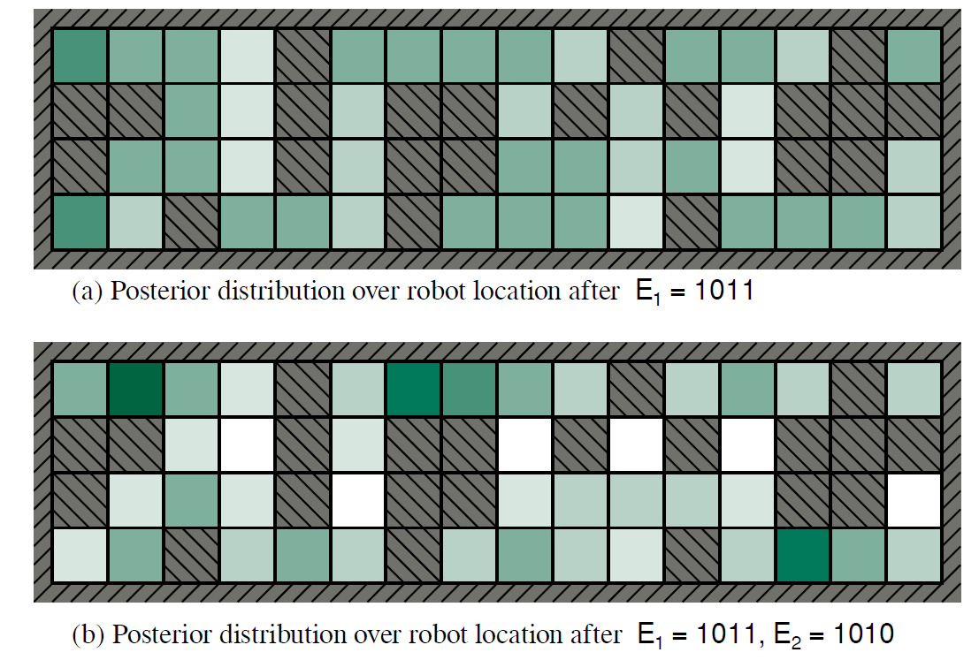
Hidden Markov Models

Slide 17
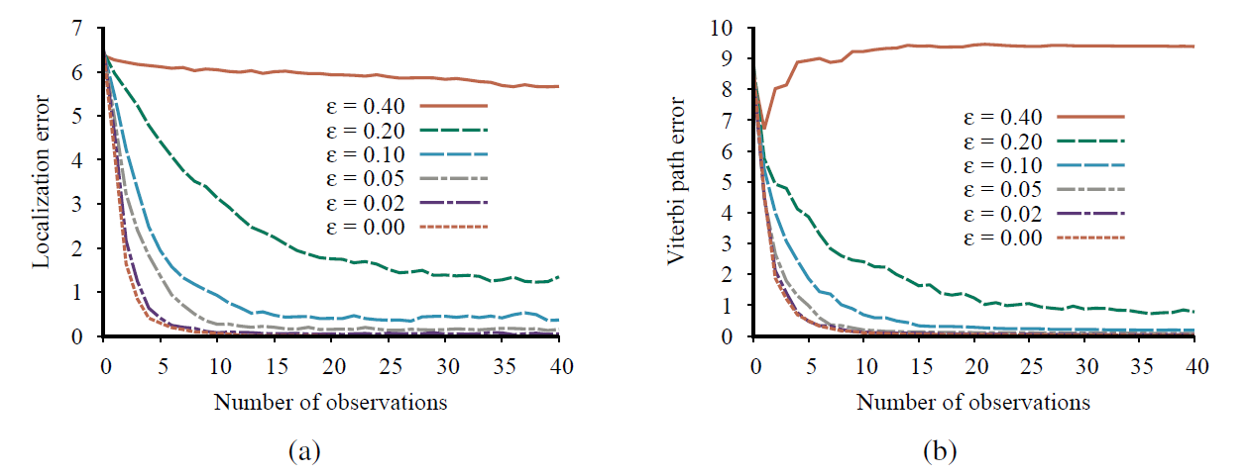
Hidden Markov Models
Performance of HMM localization as a function of the length of the observation sequence for various different values of the sensor error probability E; data averaged over 400 runs.
The localization error, defined as the Manhattan distance from the true location.
The Viterbi path error, defined as the average Manhattan distance of states on the Viterbi path from corresponding states on the true path

Slide 18

Kalman Filters
handling continuous variables
current distribution P(X_{t} e_{1:t}) is Gaussian and the transition model P(X_{t+1} x_{t}) is linear–Gaussian, then the one-step predicted distribution given by
If the prediction P(X_{t+1} e_{1:t}) is Gaussian and the sensor model P(e_{t+1} X_{t+1}) is linear– Gaussian, then, after conditioning on the new evidence, the updated distribution
Thus, the FORWARD operator for Kalman filtering takes a Gaussian forward message f_{1:t}, specified by a mean µ_{t} and covariance Σ_{t}, and produces a new multivariate Gaussian forward message f_{1:t+1}, specified by a mean µ_{t+1} and covariance Σ_{t+1}.

Slide 19


Kalman Filters
full multivariate Gaussian distribution
Mean And Covariance
Kalman Gain Matrix

Slide 20
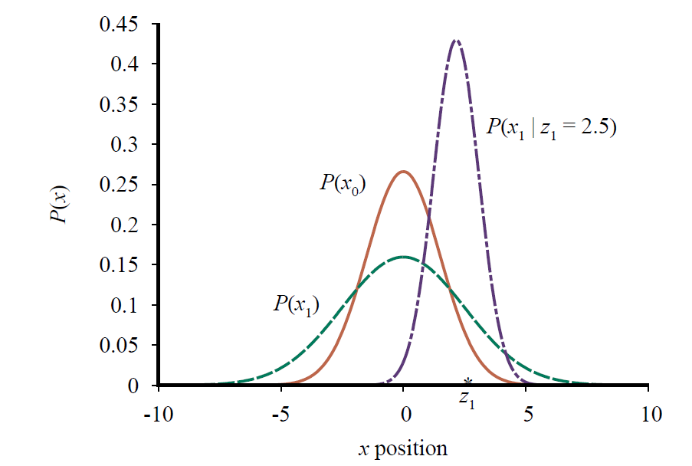
Kalman Filters
Stages in the Kalman filter update cycle for a random walk with a prior given by µ₀ = 0.0 and σ₀ = 1.5, transition noise given by σ_{x} = 2.0, sensor noise given by σ_{z} = 1.0, and a first observation z₁ = 2.5 (marked on the x-axis).

Slide 21
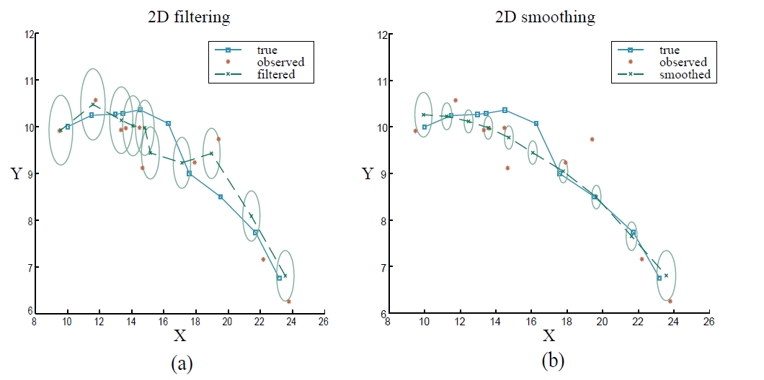
Kalman Filters
Results of Kalman filtering for an object moving on the X –Y plane, showing the true trajectory (left to right), a series of noisy observations, and the trajectory estimated by Kalman filtering. Variance in the position estimate is indicated by the ovals.
The results of Kalman smoothing for the same observation sequence.

Slide 22
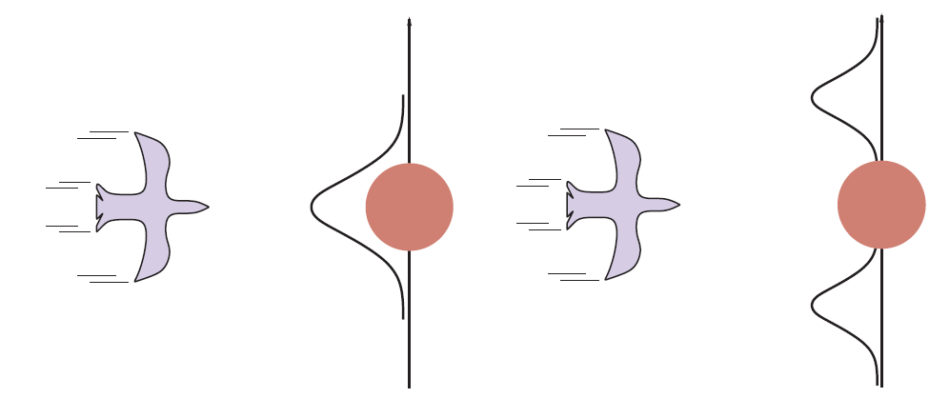
Kalman Filters
A bird flying toward a tree (top views).
A Kalman filter will predict the location of the bird using a single Gaussian centered on the obstacle.
A more realistic model allows for the bird’s evasive action, predicting that it will fly to one side or the other

Slide 23
Dynamic Bayesian Networks
Dynamic Bayesian networks, or DBNs, extend the semantics of standard Bayesian networks to handle temporal probability models
Each slice of a DBN can have any number of state variables X_{t} and evidence variables E_{t}
every hidden Markov model can be represented as a DBN with a single state variable and a single evidence variable
Every HMM is a DBN and every DBN can be translated into an HMM
By decomposing the state of a complex system into its constituent variables, we can take advantage of sparseness in the temporal probability model.
In a Kalman filter, the current state distribution is always a single multivariate Gaussian distribution. DBNs can model arbitrary distributions

Slide 24
Dynamic Bayesian Networks
Dynamic Bayesian networks, or DBNs, extend the semantics of standard Bayesian networks to handle temporal probability models
Each slice of a DBN can have any number of state variables X_{t} and evidence variables E_{t}
DBN representation size O(nd^{k}) if the number of parents of each variable is bounded by k.
every hidden Markov model can be represented as a DBN with a single state variable and a single evidence variable
Every HMM is a DBN and every DBN can be translated into an HMM
By decomposing the state of a complex system into its constituent variables, we can take advantage of sparseness in the temporal probability model.
In a Kalman filter, the current state distribution is always a single multivariate Gaussian distribution. DBNs can model arbitrary distributions

Slide 25
Dynamic Bayesian Networks
To construct a DBN, one must specify three kinds of information:
the prior distribution over the state variables, P(X₀)
the transition model P(X_{t+1} | X_{t} )
sensor model P(E_{t} | X_{t}).
Transient failure: the sensor occasionally decides to send some nonsense
for a system to handle sensor failure properly, the sensor model must include the possibility of failure
The simplest kind of failure model for a sensor allows a certain probability that the sensor will return some completely incorrect value, regardless of the true state of the world
Persistent failure model: describes how the sensor behaves under normal conditions and after failure
This persistence arc has a CPT that gives a small probability of failure in any given time step,

Slide 26
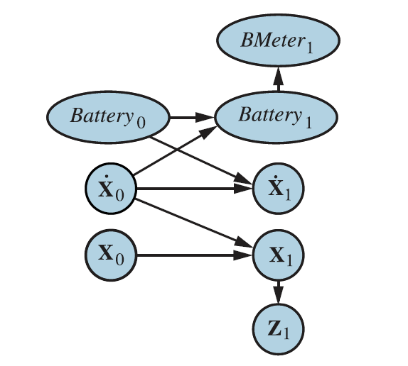
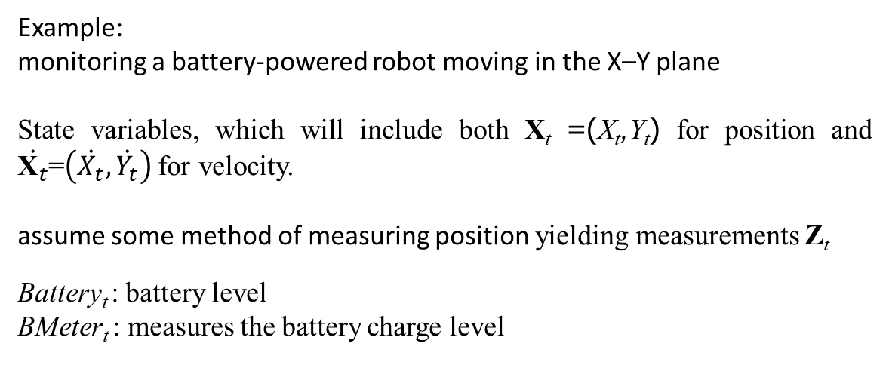
Dynamic Bayesian Networks
Example:
monitoring a battery-powered robot moving in the X–Y plane
State variables, which will include both X_{t} =(X_{t},Y_{t}) for position and $\dot{{\text{X}}_{t}}$=$\left(\dot{X_{t}},\dot{Y_{t}}\right)$ for velocity.
assume some method of measuring position yielding measurements Z_{t}
Battery_{t} : battery level
BMeter_{t} : measures the battery charge level

Slide 27
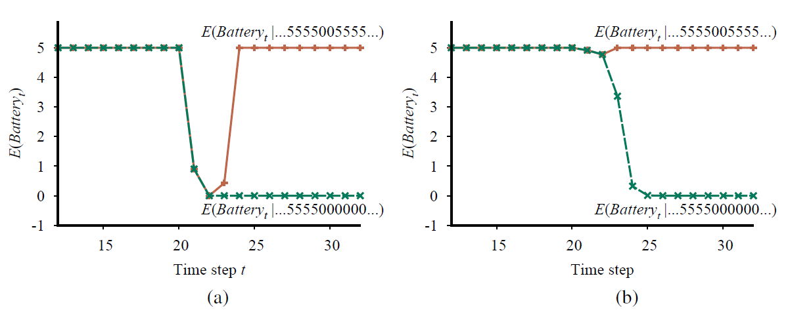
Dynamic Bayesian Networks
Upper curve: trajectory of the expected value of Battery_{t}
The same experiment run with the transient failure model

Slide 28
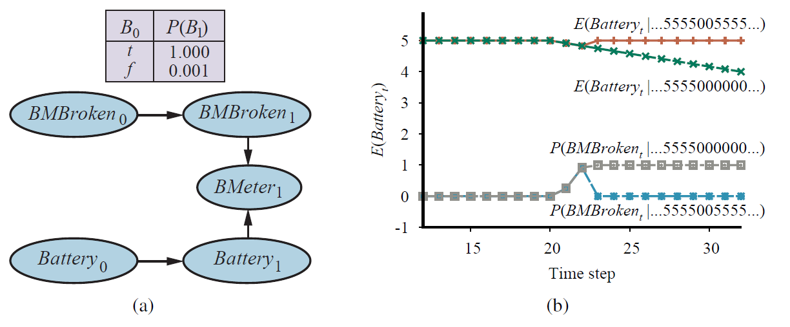
Dynamic Bayesian Networks
A DBN fragment showing the sensor status variable required for modeling persistent failure of the battery sensor.
Upper curves: trajectories of the expected value of Battery_{t} for the “transient failure” and “permanent failure” observations sequences. Lower curves: probability trajectories for BMBroken given the two observation sequences.

Slide 29
Dynamic Bayesian Networks
Exact inference in DBNs
Unrolling: construct the full Bayesian network representation of a DBN by replicating slices until the network is large enough to accommodate the observations
Once the DBN is unrolled, one can use any of the inference algorithms—variable elimination, clustering methods
the filtering update: works by summing out the state variables of the previous time step to get the distribution for the new time step (variable elimination algorithm)
The maximum factor size is O(d^{n+k}) and the total update cost per step is O(nd^{n+k}), where d is the domain size of the variables and k is the maximum number of parents of any state variable.
even though we can use DBNs to represent very complex temporal processes with many sparsely connected variables we cannot reason efficiently and exactly about those processes.

Slide 30
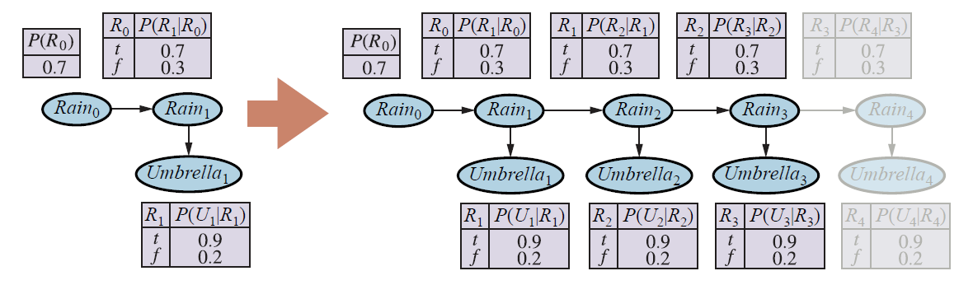
Dynamic Bayesian Networks
Unrolling a dynamic Bayesian network

Slide 31
Dynamic Bayesian Networks
Approximate inference in DBNs
Sequential importance sampling or SIS
use the samples themselves as an approximate representation of the current state distribution.
“constant” time per update
No need to unroll the DBN
to maintain a given level of accuracy, we need to increase the number of samples exponentially with t
Even with 100,000 samples, the SIS approximation fails completely after about 20 steps
Particle filtering
focus the set of samples on the high-probability regions of the state space
sequential importance sampling with resampling

Slide 32

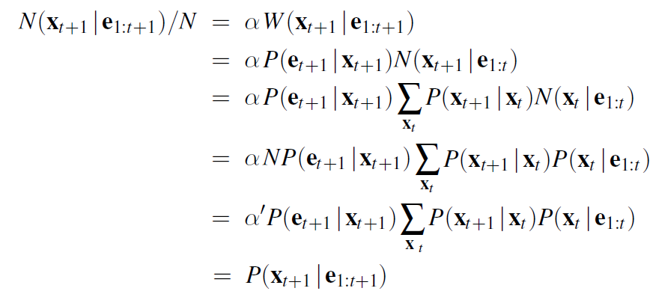
Dynamic Bayesian Networks
Particle filtering
N(x_{t} | e_{1:t}): the number of samples occupying state x_{t} after observations e_{1:t} have been processed, we therefore have
propagate each sample forward by sampling the state variables at t + 1,

Slide 33
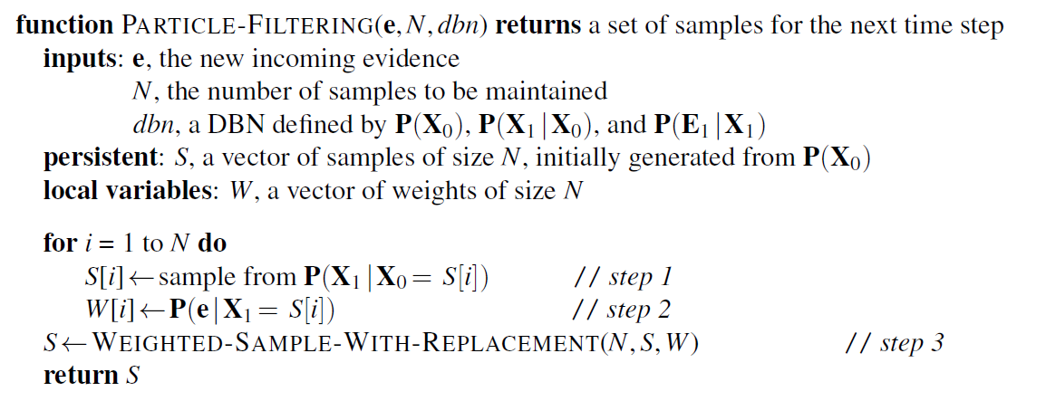
Dynamic Bayesian Networks
The particle filtering algorithm implemented as a recursive update operation with state (the set of samples). Each of the sampling operations involves sam- pling the relevant slice variables in topological order, much as in PRIOR-SAMPLE. The WEIGHTED-SAMPLE-WITH-REPLACEMENT operation can be implemented to run in O(N) expected time.

Slide 34
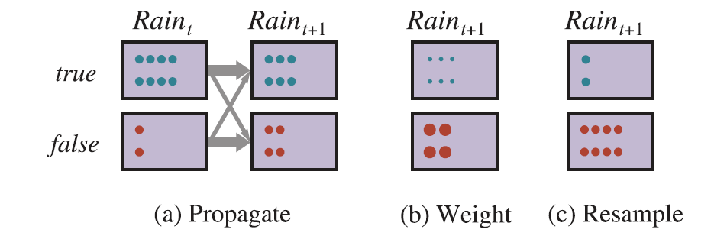
Dynamic Bayesian Networks
The particle filtering update cycle for the umbrella DBN with N=10, showing the sample populations of each state.

Slide 35
Dynamic Bayesian Networks
The particle filtering algorithm weakness:
Possible the initial guesses in each particle are never updated by the evidence.
Best particles will come to dominate the total likelihood as time progresses and the diversity of the population of particles will collapse.
all the particles agree on a single, incorrect map, the algorithm becomes convinced that that map is correct and never changes its mind
Rao-Blackwellization particle filter
Exact inference is always more accurate than sampling, even if it’s only for a subset of the variables
For the SLAM problem, we run particle filtering on the robot location and then, for each particle, we run exact HMM inference for each dirt square independently, conditioned on the location sequence in that particle

Slide 36
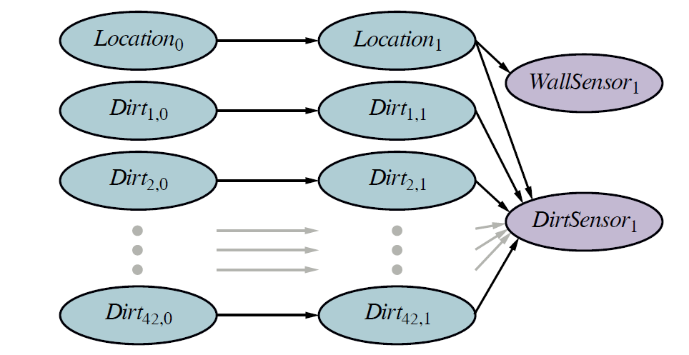
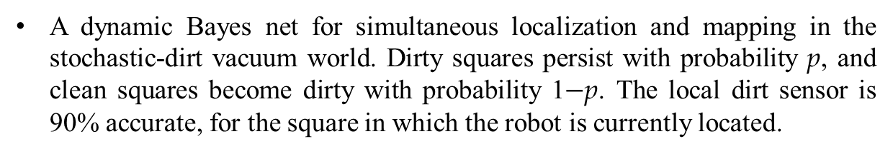
Dynamic Bayesian Networks
A dynamic Bayes net for simultaneous localization and mapping in the stochastic-dirt vacuum world. Dirty squares persist with probability p, and clean squares become dirty with probability 1$−$p. The local dirt sensor is 90% accurate, for the square in which the robot is currently located.

Slide 37
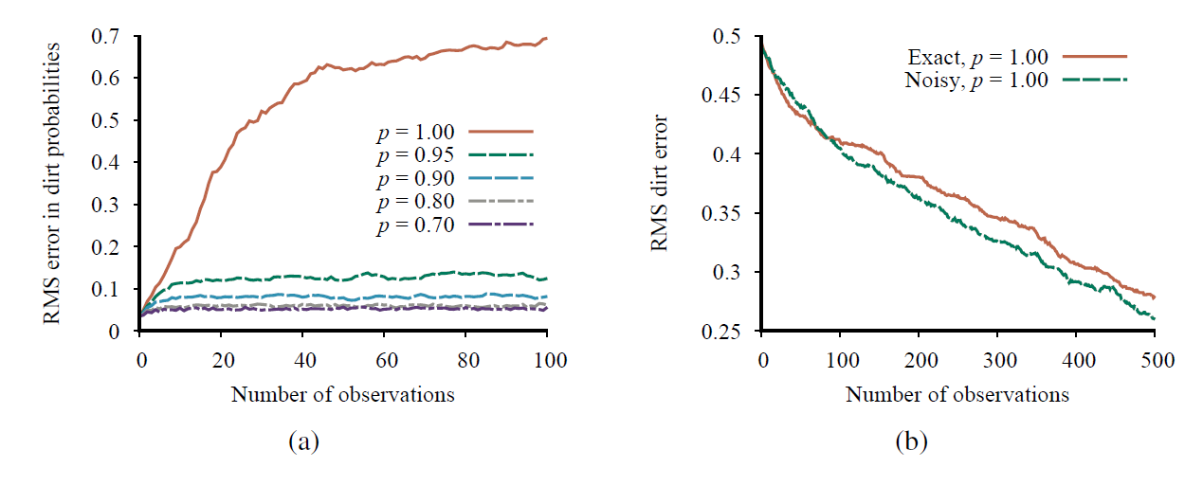
Dynamic Bayesian Networks
Performance of the standard particle filtering algorithm with 1,000 particles, showing RMS error in marginal dirt probabilities compared to exact inference for different values of the dirt persistence p.
Performance of Rao-Blackwellized particle filtering (100 particles) compared to ground truth, for both exact location sensing and noisy wall sensing and with deterministic dirt. Data averaged over 20 runs.

Slide 38
Summary
The changing state of the world is handled by using a set of random variables to represent the state at each point in time.
Representations can be designed to (roughly) satisfy the Markov property, so that the future is independent of the past given the present. Combined with the assumption that the process is time-homogeneous, this greatly simplifies the representation.
A temporal probability model can be thought of as containing a transition model describing the state evolution and a sensor model describing the observation process.
The principal inference tasks in temporal models are filtering (state estimation), prediction, smoothing, and computing the most likely explanation.
In practice, the particle filtering algorithm and its descendants are an effective family of approximation algorithms

